Slide 1
zaffre: T fuel cycle model
M. Coleman

Slide 2
zaffre: T fuel cycle model
A 0-D, dynamic (i.e. unsteady, and not time-averaged), tritium fuel cycle model
Monte Carlo runs on pseudo-randomly generated fusion load signals over the full reactor lifespan
Calculates the T inventory, start-up inventory, and reactor doubling time
Picard iterations to converge start-up inventory
Design assumptions:
EU DEMO-like fuel cycle model (with direct internal recycling)
T self-sufficiency
Not solving chemical balance or diffusion equations!
Logical flow model
Accounts for T sequestration
Accounts for T decay

Slide 3
Fuel cycle high-level requirements
1: Tritium self-sufficiency
Never need to buy tritium (again)
Always enough tritium in TFV systems to operate
Need a stockpile to protect from outages
2: Minimise the start-up inventory
3: Provide start-up inventory for another reactor
Need to create a surplus of tritium
But, how much?
And when?

Slide 4
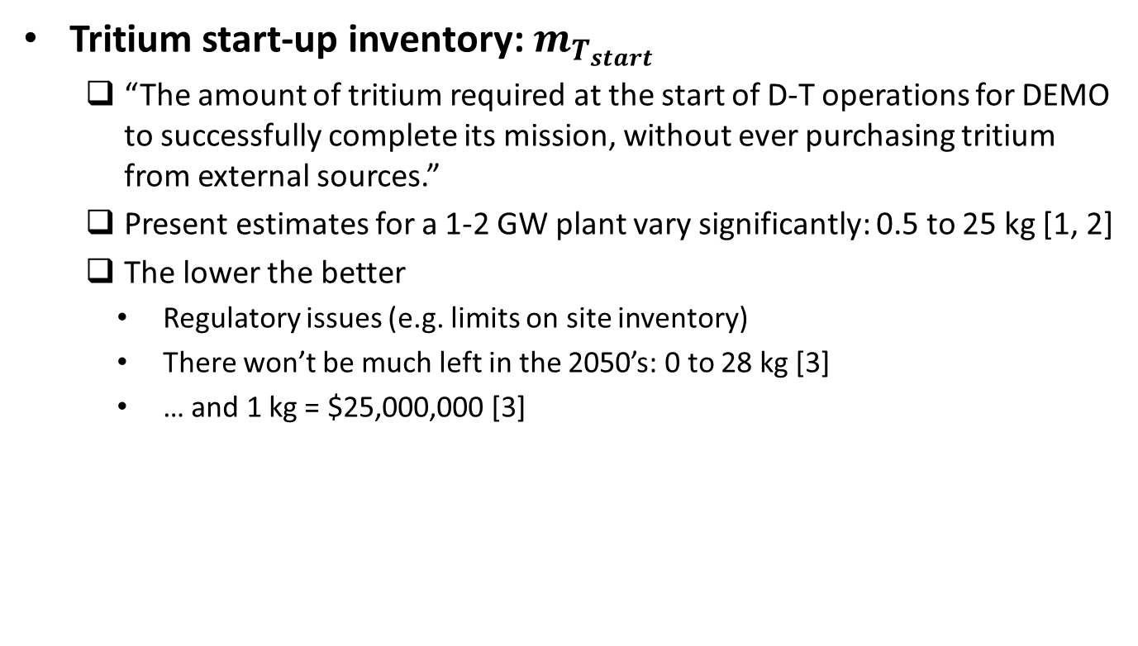

Global fuel cycle performance: $m_{T_{start}}$
Tritium start-up inventory: $m_{T_{start}}$
“The amount of tritium required at the start of D-T operations for DEMO to successfully complete its mission, without ever purchasing tritium from external sources.”
Present estimates for a 1-2 GW plant vary significantly: 0.5 to 25 kg [1, 2]
The lower the better
Regulatory issues (e.g. limits on site inventory)
There won’t be much left in the 2050’s: 0 to 28 kg [3]
… and 1 kg = $25,000,000 [3]
[1] Ni M., Wang Y., Yuan B., Jiang J. and Wu Y. 2013 Tritium supply assessment for ITER and DEMOnstration power plant Fus. Eng. Des. 88 2422–6
[2] Kasada R., Kwon S., Konishi S., Sakamoto Y., Yamanishi T. and Tobita K. 2015 A system dynamics model for stock and flow of tritium in fusion power plant Fus. Eng. Des. 98–9 1804–7
[3] Kovari M., Coleman M., Cristescu I., and Smith R. 2018 Tritium resources available for fusion reactors Nucl. Fus. 58 026010

Slide 5
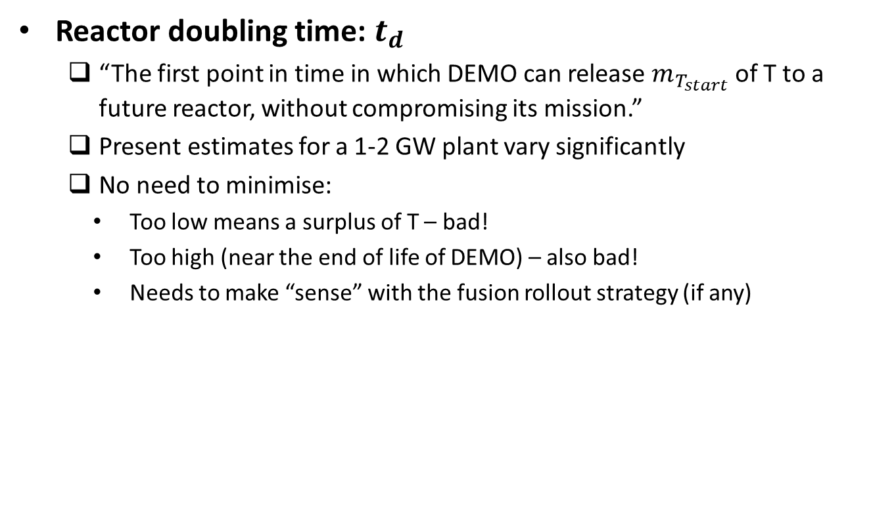

Global fuel cycle performance: $t_{d}$
Reactor doubling time: $t_{d}$
“The first point in time in which DEMO can release $m_{T_{start}}$ of T to a future reactor, without compromising its mission.”
Present estimates for a 1-2 GW plant vary significantly
No need to minimise:
Too low means a surplus of T – bad!
Too high (near the end of life of DEMO) – also bad!
Needs to make “sense” with the fusion rollout strategy (if any)

Slide 6
Some questions…
How good is a reactor’s fuel cycle?
How much T do we need to buy?
Do we need Direct Internal Recycling?
Where should we focus our R&D to improve the performance?
E.g. what is more important: TBR or dwell time?
What are some reasonable requirements for key design parameters?
E.g. what should the TBR be?
E.g. what is a minimum acceptable burn-up fraction?

Slide 7
Some questions…
How good is a reactor’s fuel cycle?
How much T do we need to buy?
Do we need Direct Internal Recycling?
Where should we focus our R&D to improve the performance?
E.g. what is more important: TBR or dwell time?
What are some reasonable requirements for key design parameters?
E.g. what should the TBR be?
E.g. what is a minimum acceptable burn-up fraction?

Slide 8
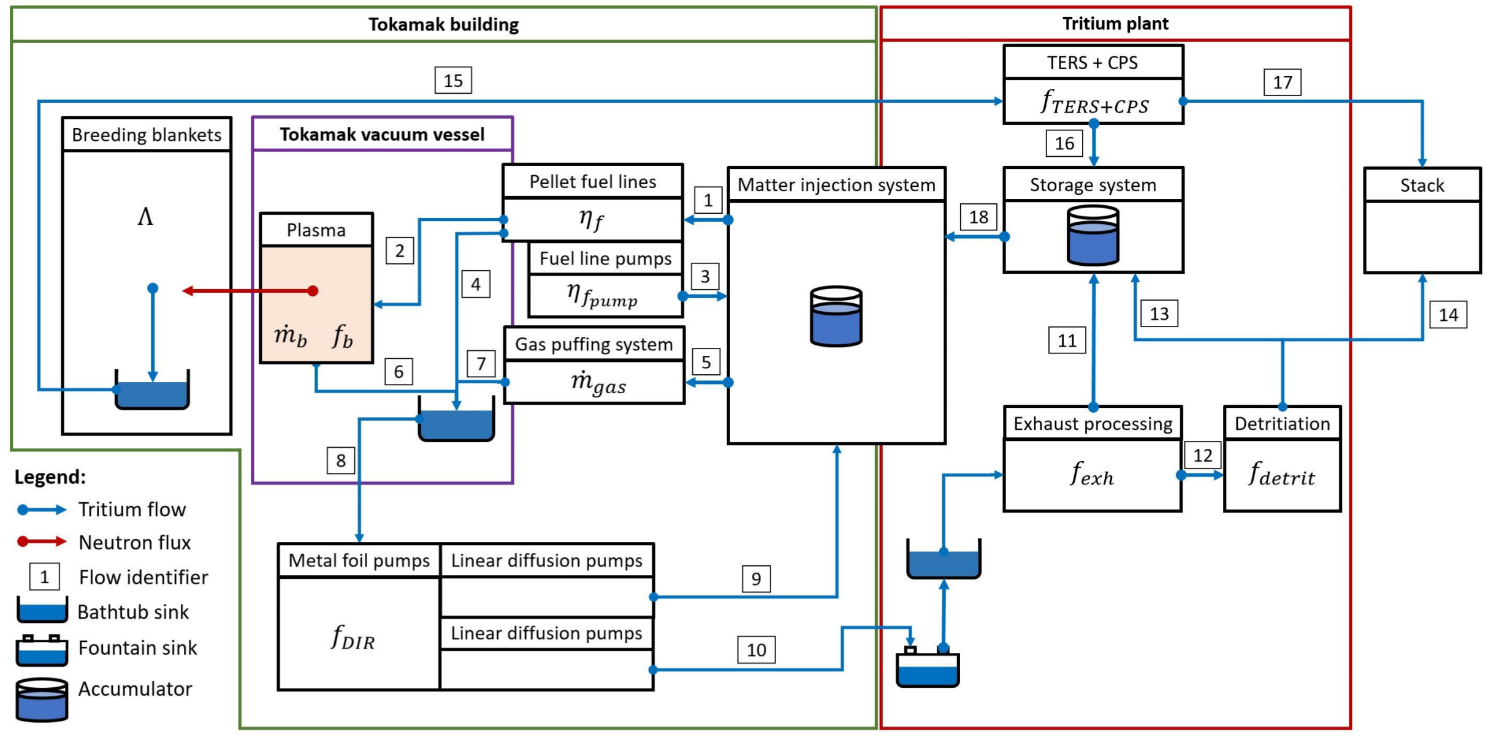
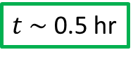
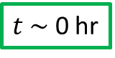
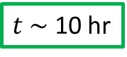
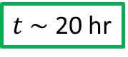

Fuel cycle model overview
$t \sim$ 10 hr
$t \sim$ 0 hr
$t \sim$ 0.5 hr
$t \sim$ 5 hr
$t \sim$ 20 hr

Slide 9
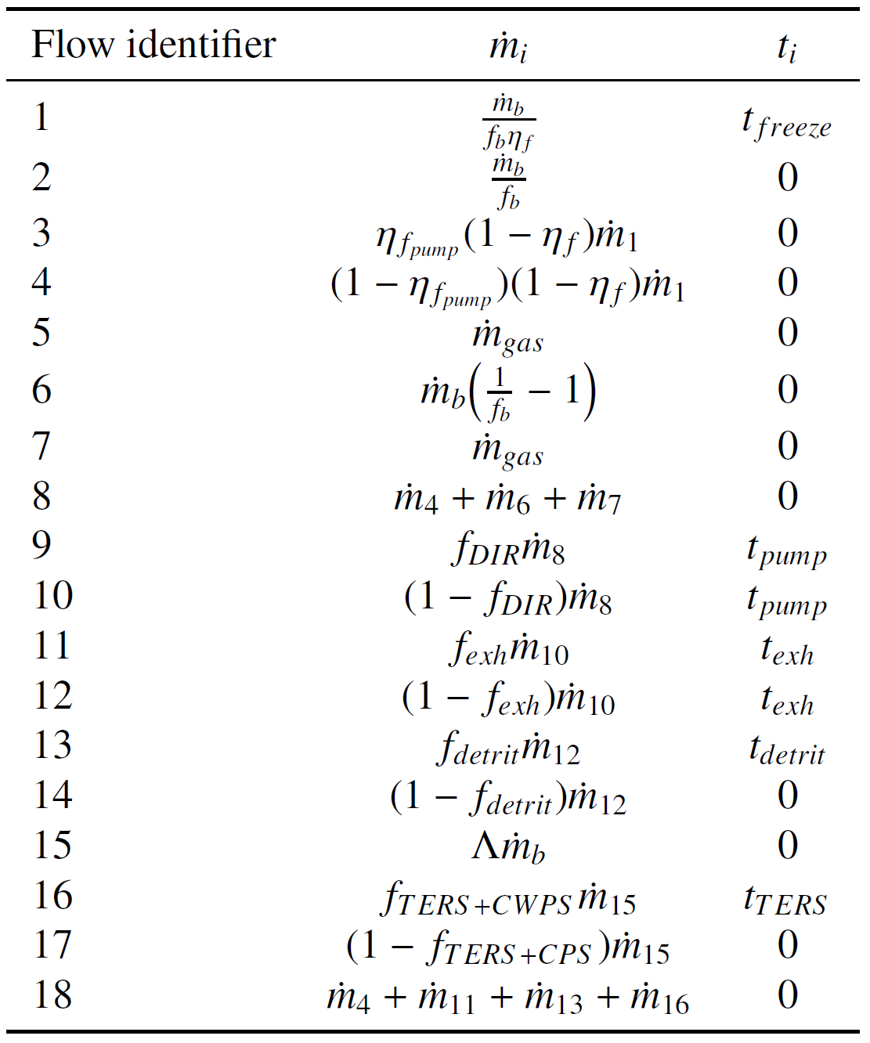
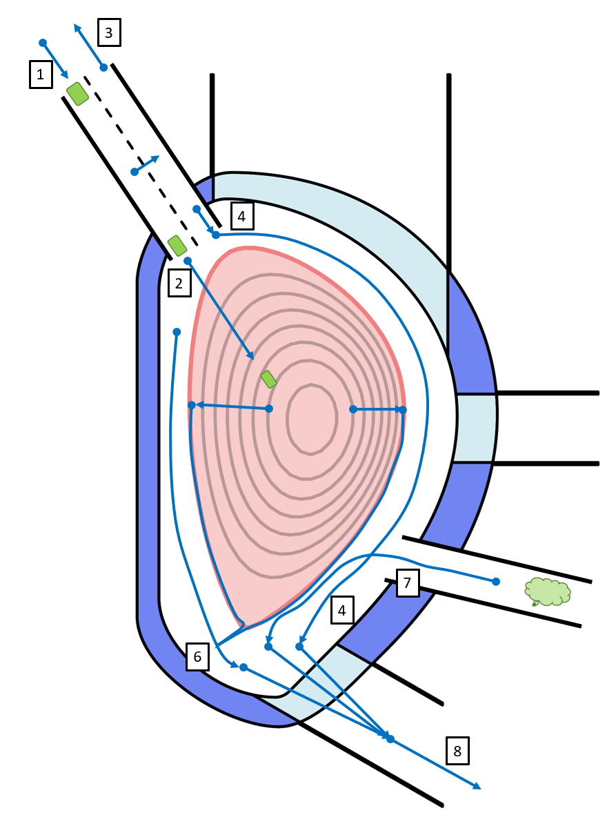

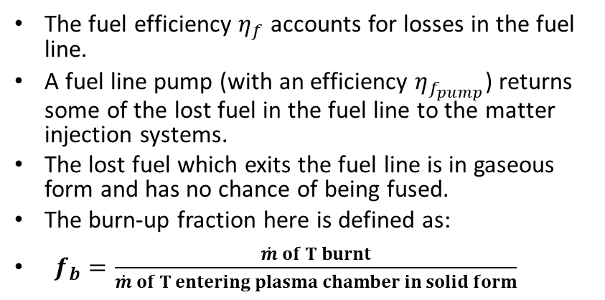
Burn-up fraction $f_{b}$ (detail def.)
The fuel efficiency $η_{f}$ accounts for losses in the fuel line.
A fuel line pump (with an efficiency $η_{f_{pump}}$) returns some of the lost fuel in the fuel line to the matter injection systems.
The lost fuel which exits the fuel line is in gaseous form and has no chance of being fused.
The burn-up fraction here is defined as:
$f_{b}=\frac{\dot{m} of T burnt}{\dot{m} of T entering plasma chamber in solid form}$

Slide 10
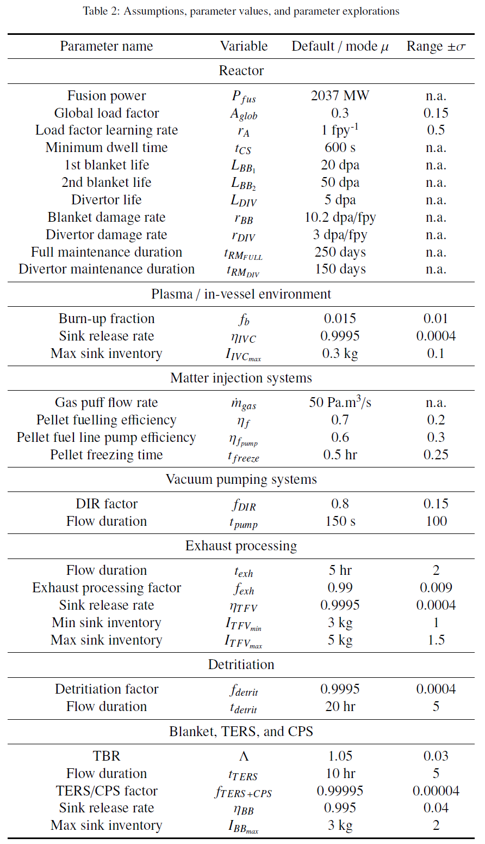
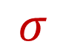

Fuel cycle parameters
$μ$
$σ$

Slide 11
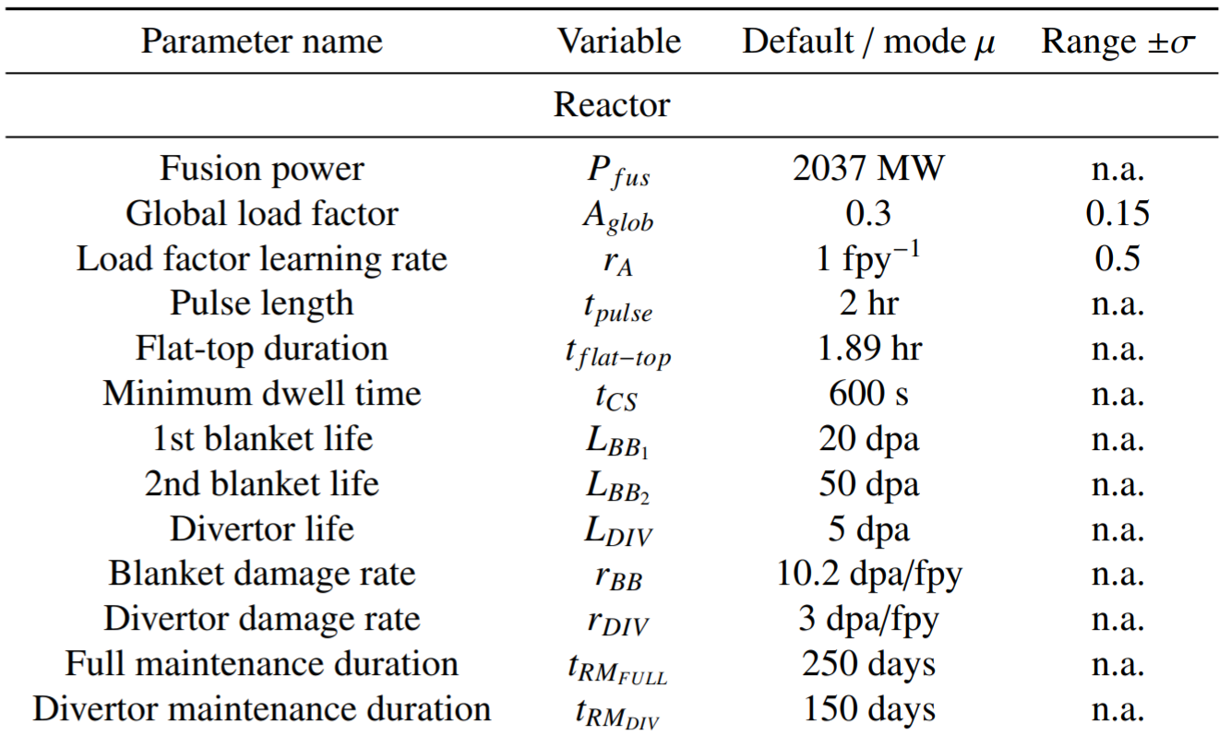
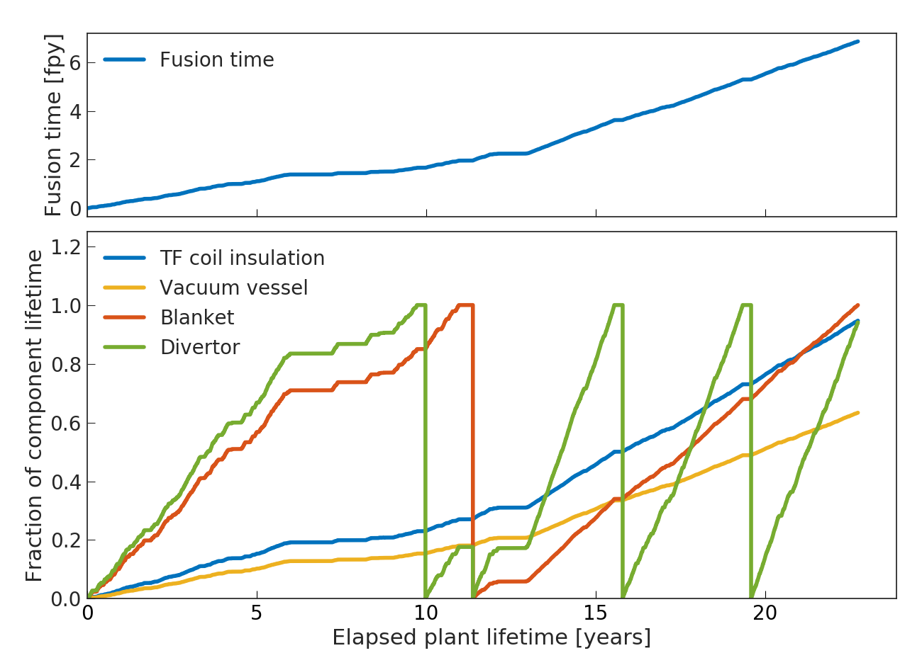
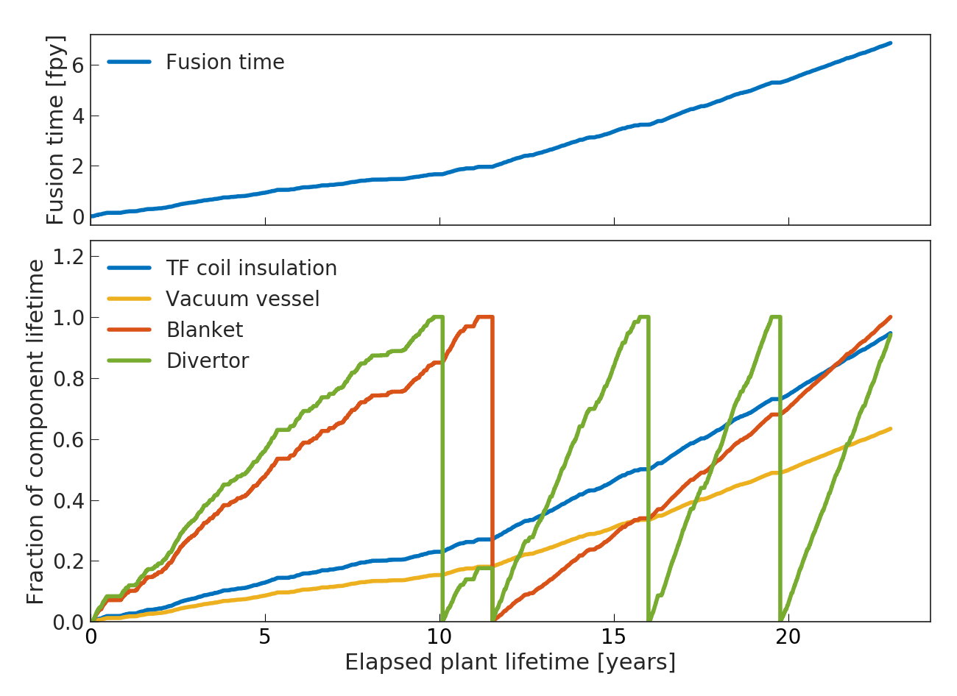
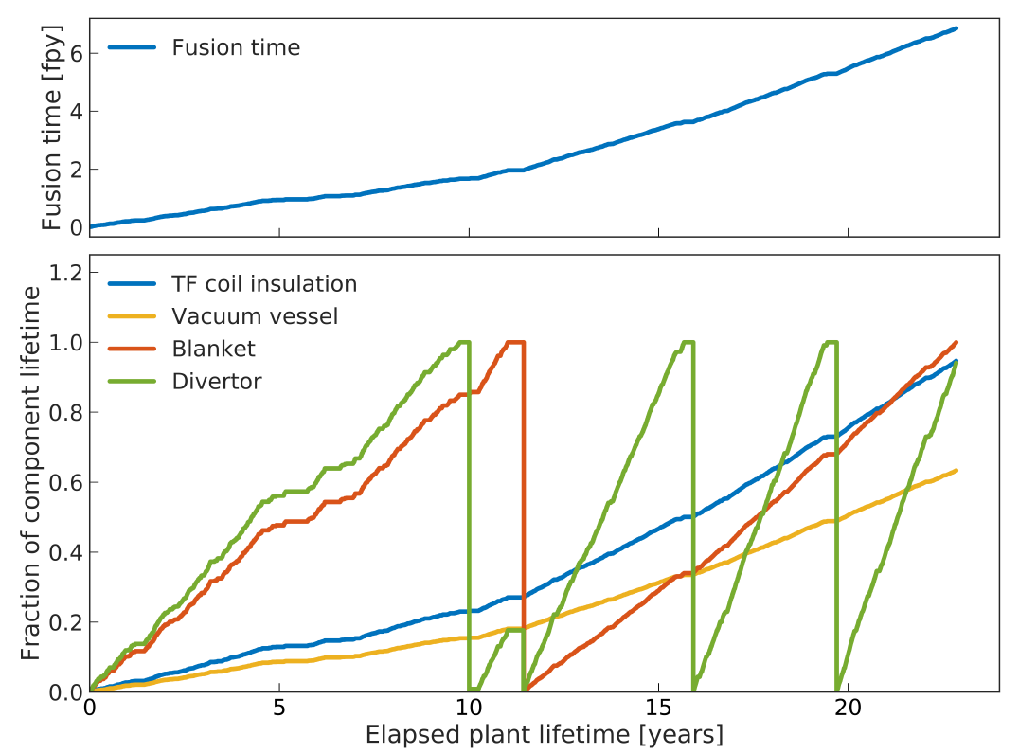
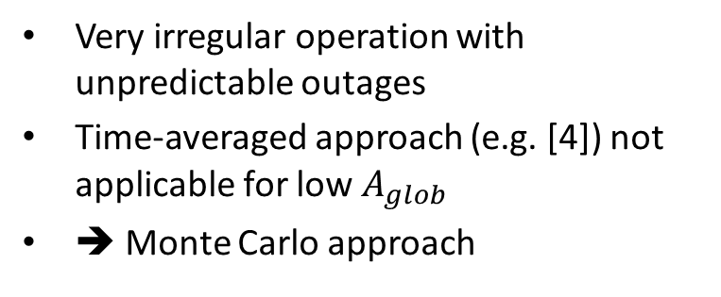
Reactor lifecycle and the load factor problem
Pseudo-random timeline generator
Very irregular operation with unpredictable outages
Time-averaged approach (e.g. [4]) not applicable for low $A_{glob}$
➔ Monte Carlo approach
[4] Kuan W. and Abdou M. A., 1999 A new approach for assessing the required tritium breeding ratio and startup inventory in future fusion reactors, Fus. Tech. 35:3 309-353

Slide 12
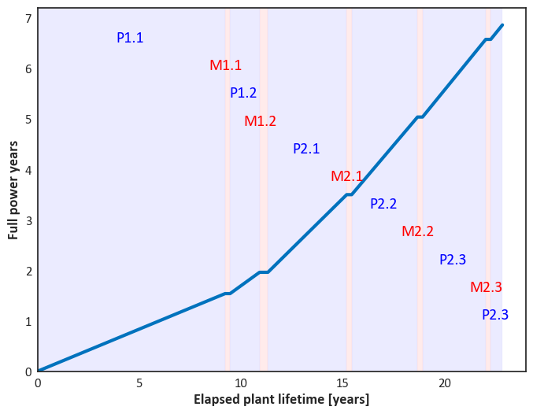
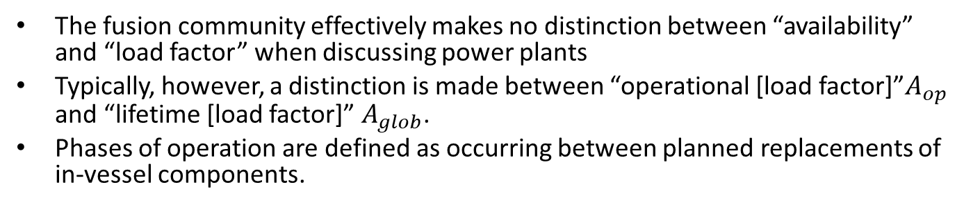
Lifecycle parameterisation
The fusion community effectively makes no distinction between “availability” and “load factor” when discussing power plants
Typically, however, a distinction is made between “operational [load factor]”$A_{op}$ and “lifetime [load factor]” $A_{glob}$.
Phases of operation are defined as occurring between planned replacements of in-vessel components.
Thus:
$$\overline{A_{op}}=\frac{t_{fus}}{\frac{t_{fus}}{A}−t_{m}}$$
It is commonly accepted that the load factor will be low to begin with, and improve as operational experience develops.
This is important as low load factors at the start of life increase the amount of external tritium required.

Slide 13
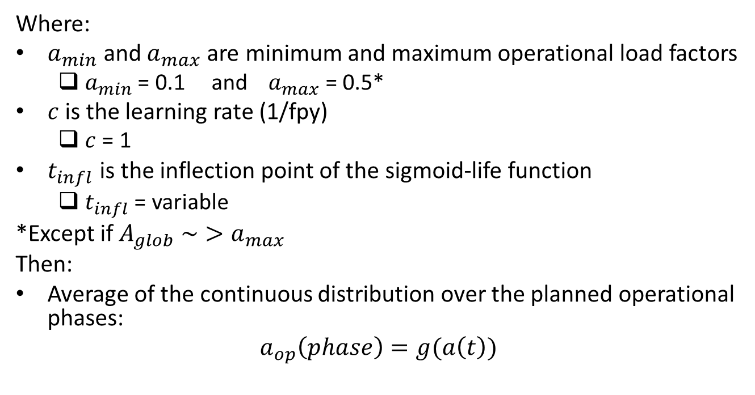
Lifecycle parameterisation
Gompertz parameterisation for the load factor learning curve
$$a\left(t\right)=a_{min}+\left(a_{max}−a_{min}\right)e^{−\frac{\ln\left(2\right)}{e^{−ct_{infl}}}e^{−ct}}$$
Where:
$a_{min}$ and $a_{max}$ are minimum and maximum operational load factors
$a_{min}$ = 0.1 and$a_{max}$ = 0.5*
$c$ is the learning rate (1/fpy)
$c$ = 1
$t_{infl}$ is the inflection point of the sigmoid-life function
$t_{infl}$ = variable
*Except if $A_{glob} \sim >a_{max}$
Then:
Average of the continuous distribution over the planned operational phases:
$$a_{op}\left(phase\right)=g(a\left(t\right))$$

Slide 14
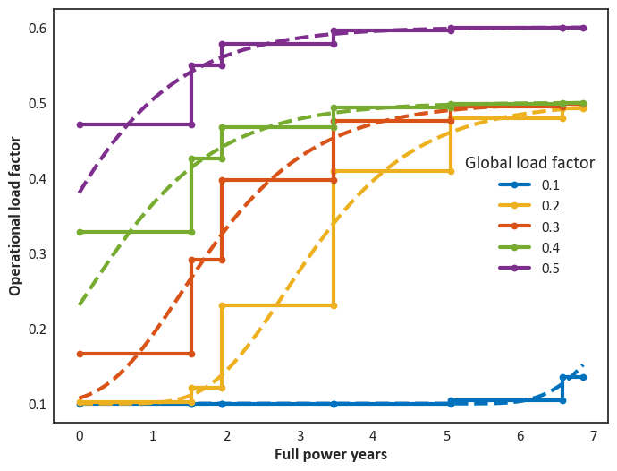
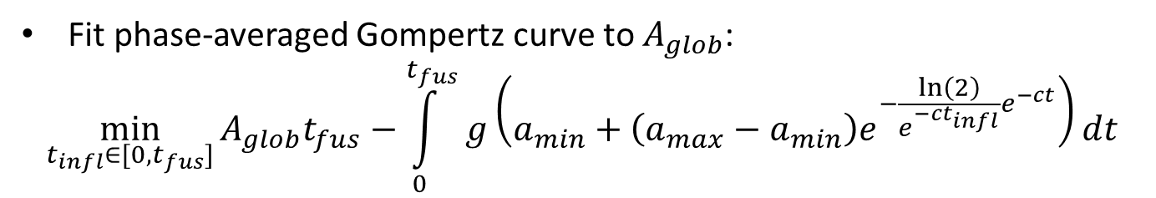
Lifecycle parameterisation
Fit phase-averaged Gompertz curve to $A_{glob}$:
$$\min_{t_{infl}∈[0, t_{fus}]}{A_{glob}t_{fus}−\int_{0}^{t_{fus}}{g\left(a_{min}+\left(a_{max}−a_{min}\right)e^{−\frac{\ln\left(2\right)}{e^{−ct_{infl}}}e^{−ct}}\right)dt}}$$
Minimised with the Brent-Dekker algorithm (Brent, 1973)
For an input $A_{glob}$, outputs an array $A_{op}$, for the defined learning rates and load factor constraints

Slide 15
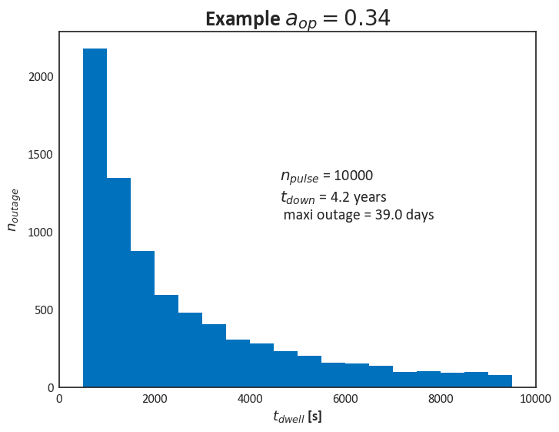
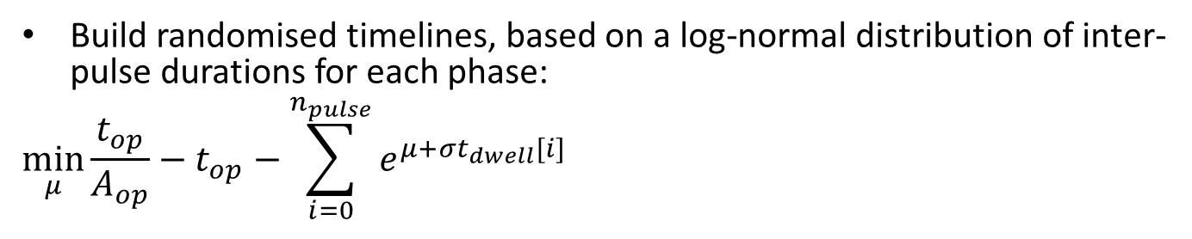
Timeline generation
Build randomised timelines, based on a log-normal distribution of inter-pulse durations for each phase:
$$\min_{μ}{\frac{t_{op}}{A_{op}}−t_{op}−\sum_{i=0}^{n_{pulse}}{e^{μ+σt_{dwell}[i]}}}$$
Minimised with the Brent-Dekker algorithm (Brent, 1973)
For a given phase duration and load factor, outputs a set of a random inter-pulse durations drawn from a log-normal distribution
The minimum inter-pulse duration is the time to recharge the Central Solenoid (reverse current)

Slide 16
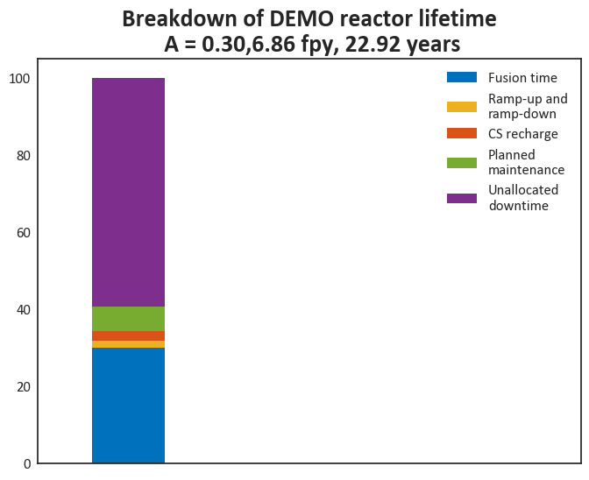
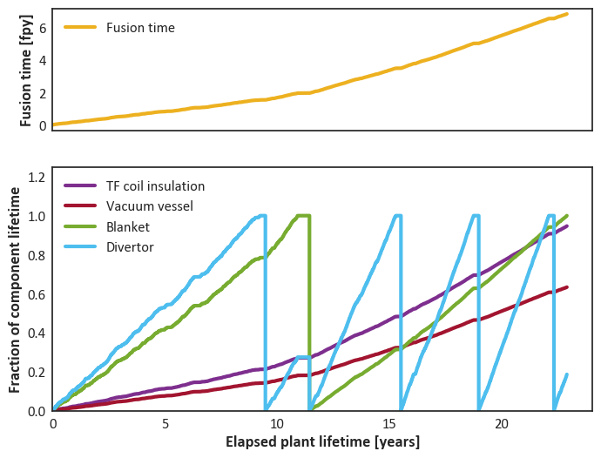
Typical timeline with component lifetimes/replacements

Slide 17
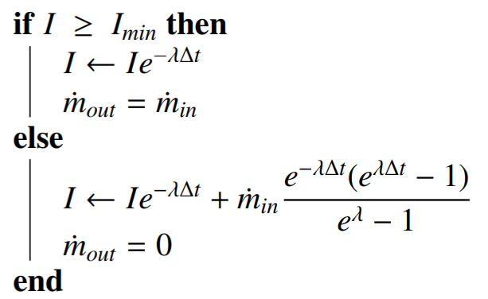
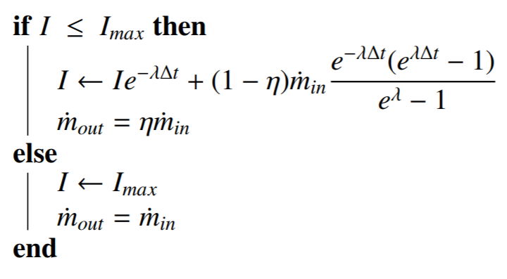
Sequestration models
Fountain
Fountain + Bathtub
Bathtub
Bathtub
Bathtub

Slide 18

Default case ($f_{DIR}$ = 0.8)
T in fuel cycle and stores
Sequestered T in sinks

Slide 19
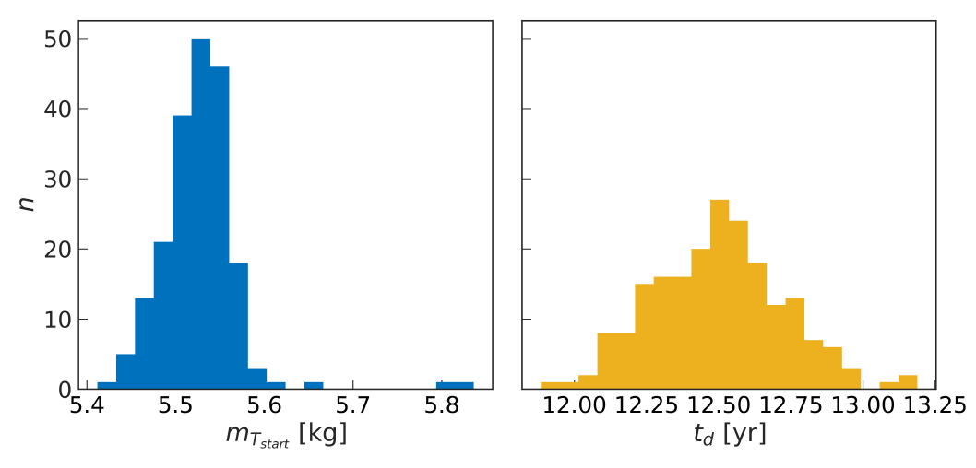
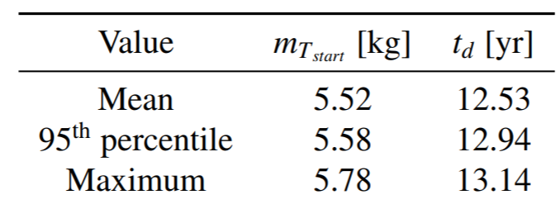
Default case ($f_{DIR}$ = 0.8)
n = 200

Slide 20
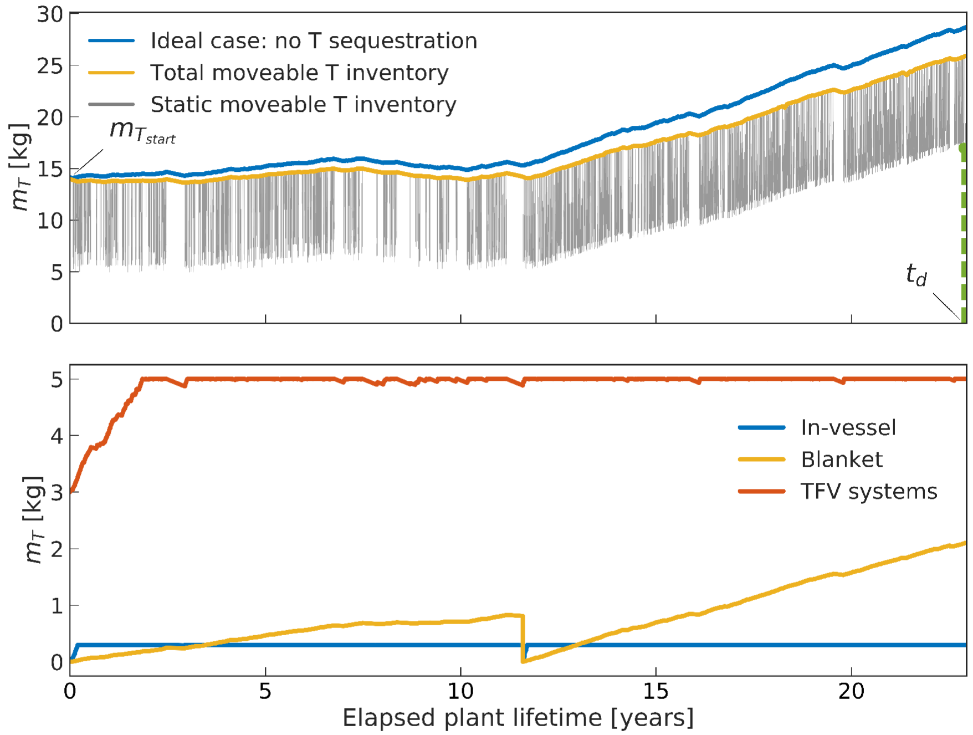
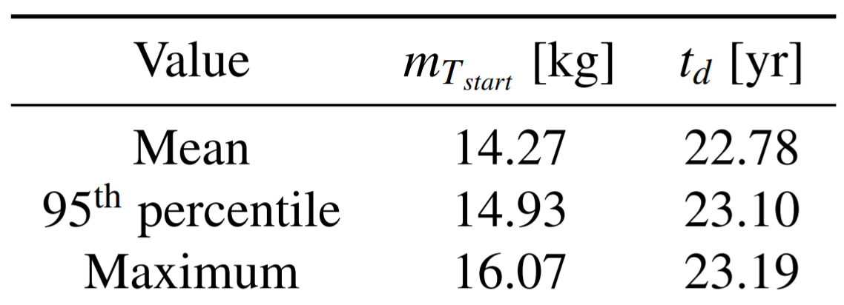

Default case ($f_{DIR}$ = 0)
n = 200

Slide 21
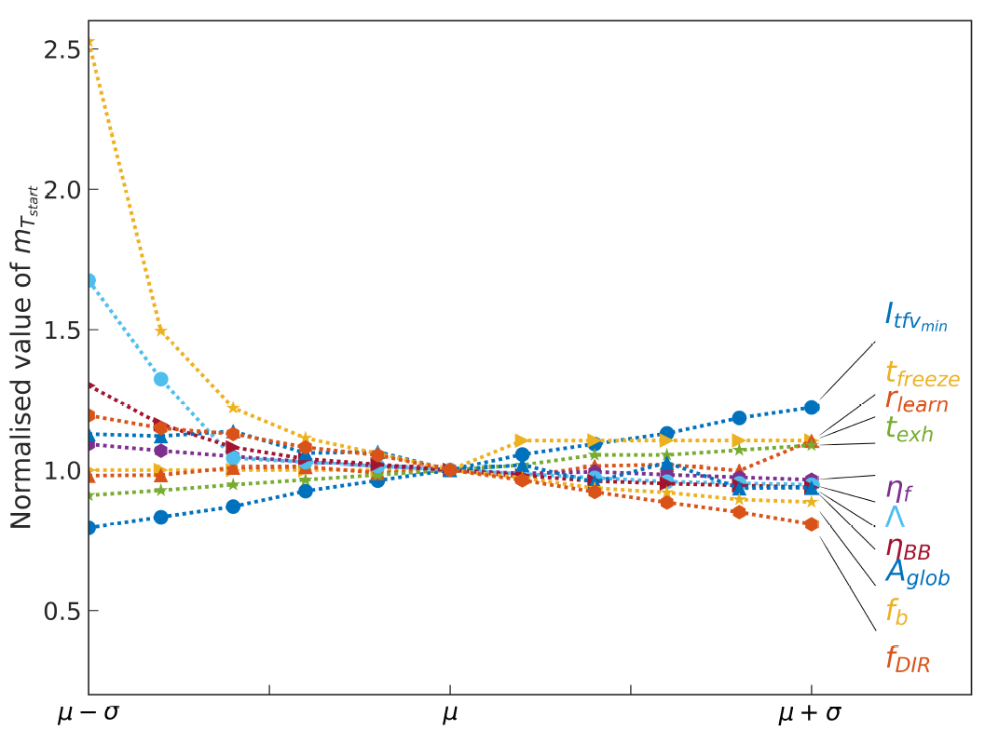
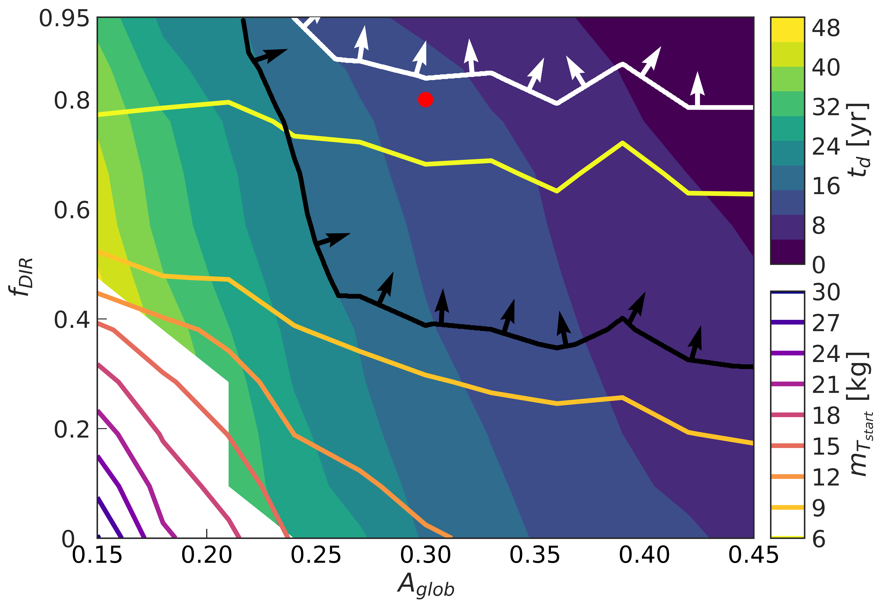
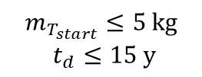
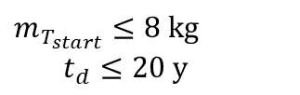
zaffre sensitivity study results
Baseline
$m_{T_{start}}≤8 kg$
$t_{d}≤20 y$
$$m_{T_{start}}≤5 kg$$
$t_{d}≤15 y$

